Slide 1
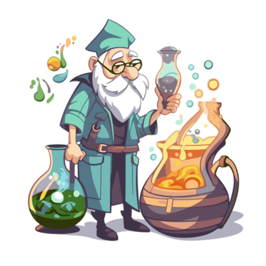
The Anime Alchemist
Your Playful Guide to Otaku Wonderland !
By imen abidi, WBS school 2024

Slide 2

Facts on Anime
36% (or 2.88 billion) of viewers worldwide enjoyed watching in 2021
over 186,700 different titles (The Japanese Media Arts Database 2022)

Slide 3

The Anime AlchemisT App
Get recommendation
Add Rating and create a personnel list
Anime specialised Chatbot

Slide 4

Data
Data Collection
Api
Web scraping
Data cleaning
Create Database

Slide 5

The Anime Alchemist

Slide 6
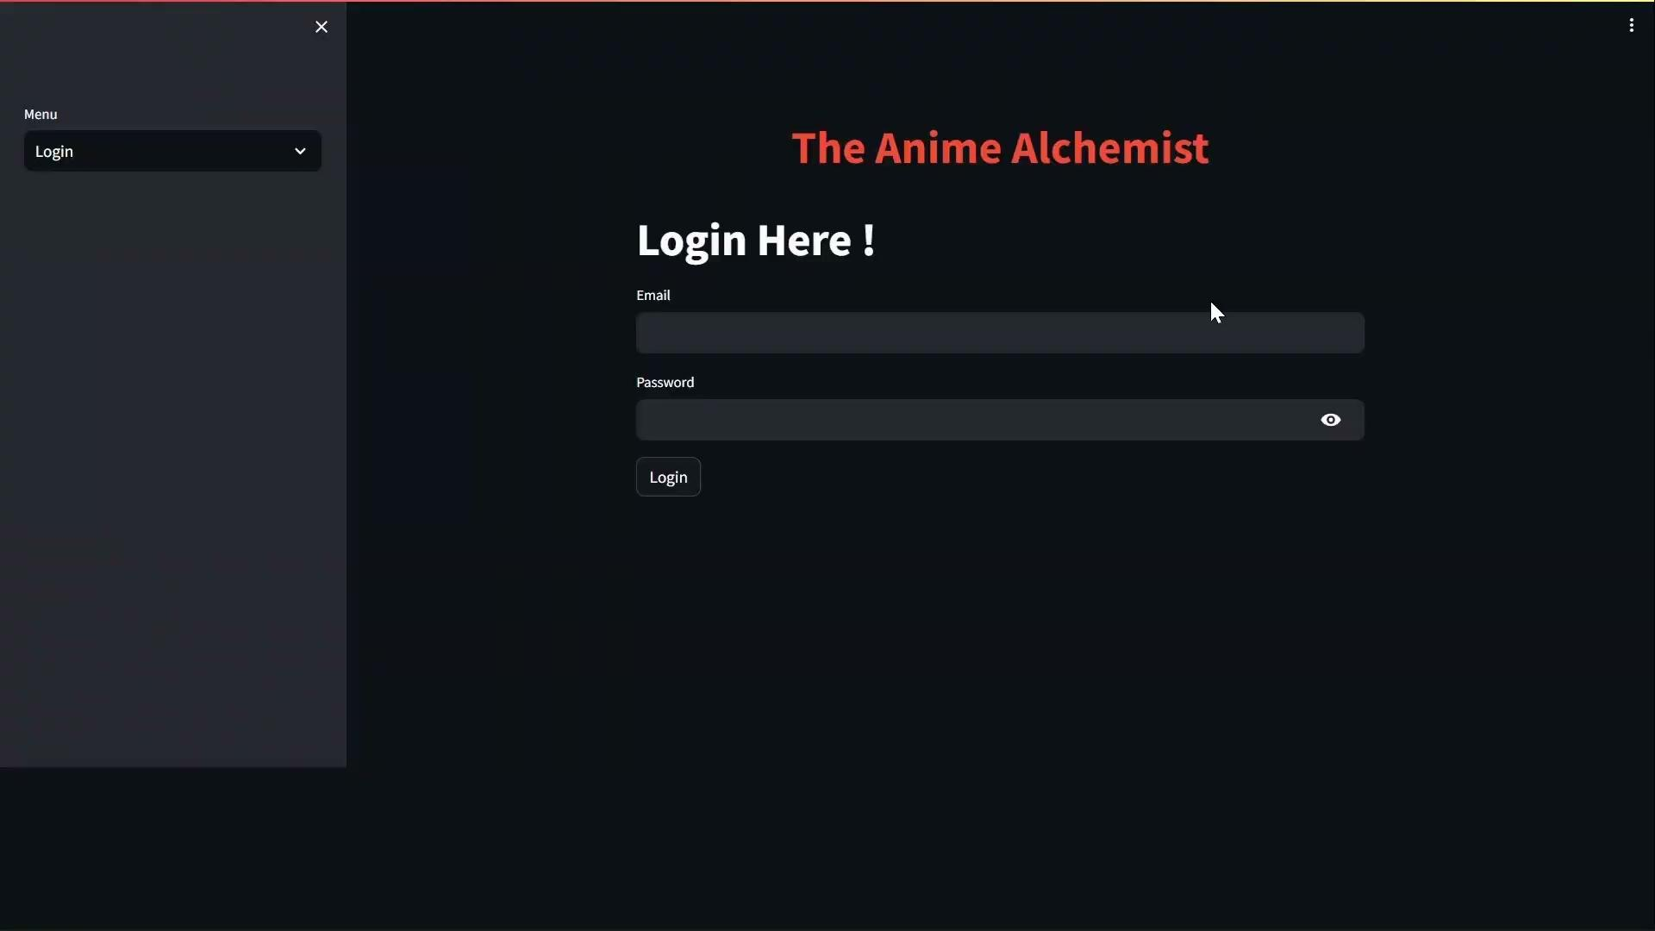

Slide 7
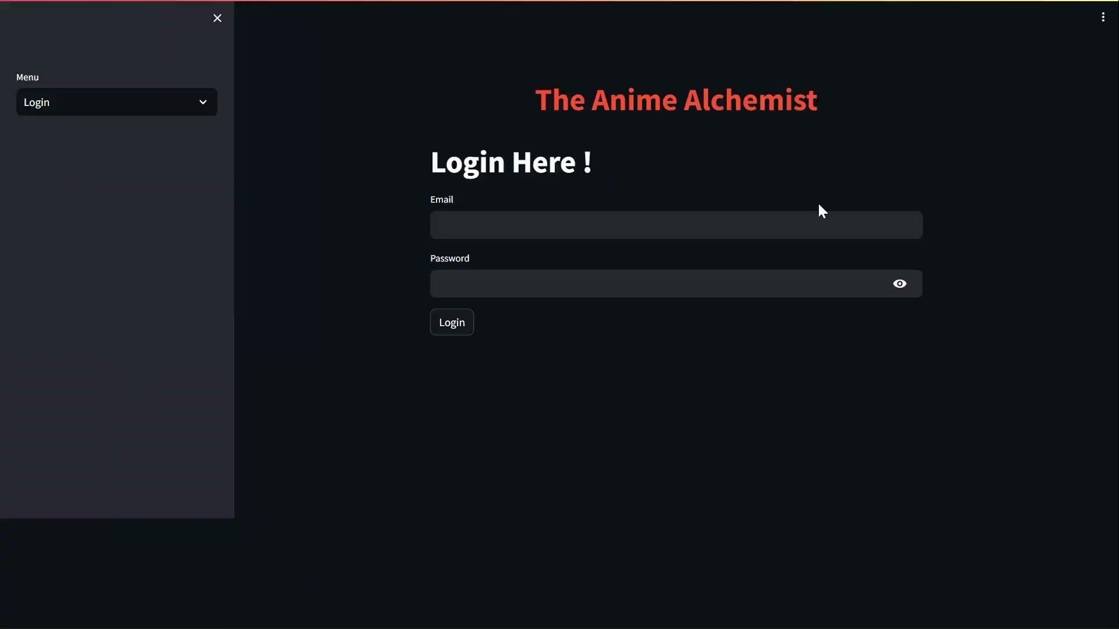

Slide 8



to do
chatbot that can play role and answer as it is an anime character that the user choose
Appliying Machine learning algrighme to predict the scores of new releases
Create a proper Front end

Slide 9















thank you
Any questions?

Slide 10

appendix

Slide 11


